Slide 1

Brain Hemorrhage Classification with CT scans
David Pogrebitskiy, Scott Biggs, Thomas Walewski, Jared Garfinkel, Karenna Ng, and Sarah Baker
Notes:
yo

Slide 2
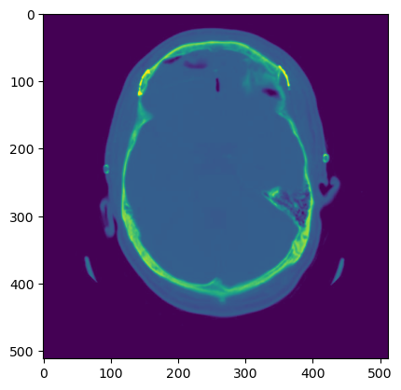
Background
Want to predict the occurrence and type of brain hemorrhages
Model could be used to aid medical evaluation of CT scans
Model predicts scan outcome and then human professional validates
Using image data from CT scans (XN data source)
Images taken from different sections of the head
Notes:
Scott

Slide 3
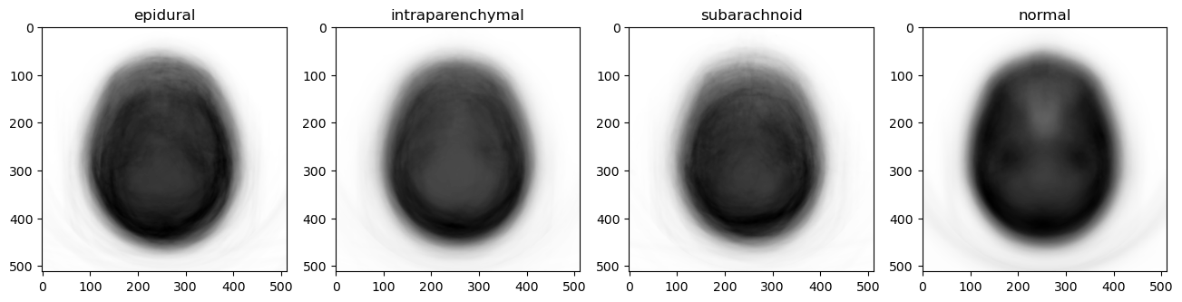
Describing the Data
Six Categories:
Epidural
Intraparenchymal
Multiple
Normal
Subarachnoid
Subdural
750,000+ total images
Notes:
Karenna

Slide 4
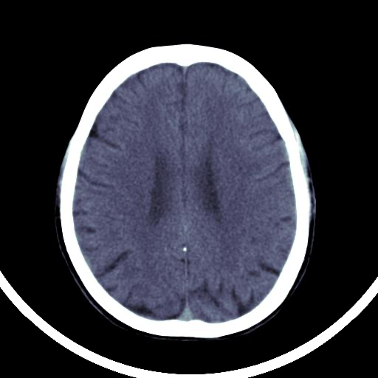
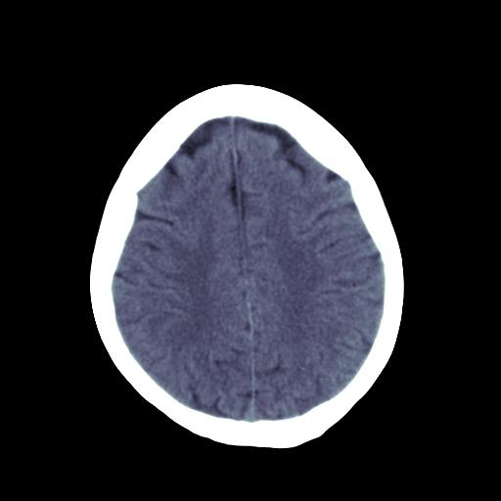

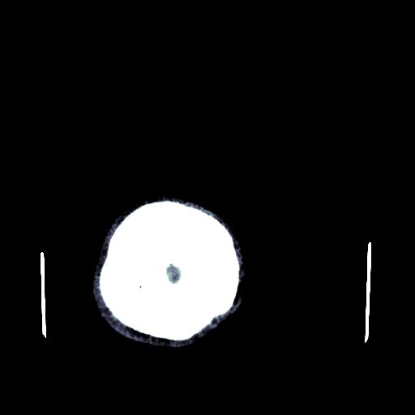
Cleaning the Data
Used the brain bone window, which performed best on a test algorithm
CT scans taken from different points in the head
Want to select images that have clear hemorrhages
Use brightness levels to parse CT scans to find quality images
Around 8,000 entries used for data analysis
Needed to make labels match for images selected for the models
Notes:
Thomas

Slide 5
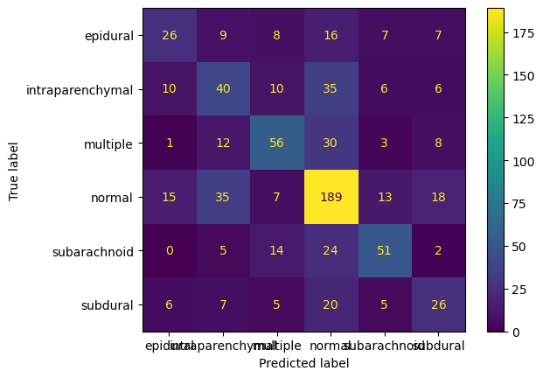
Model 1: Logistic Regression
SoftMax Logistic Regression
No Down Sampling
80/20 Split in Training/Testing
732 entries in the test data
53% model accuracy
Brought up by ability to predict "normal" cases
Other classes range for 36% to 53% accuracy

Slide 6
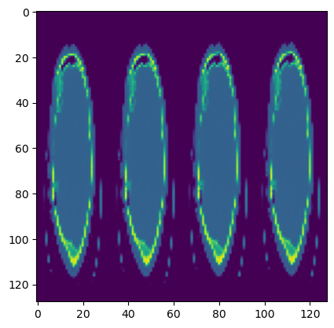
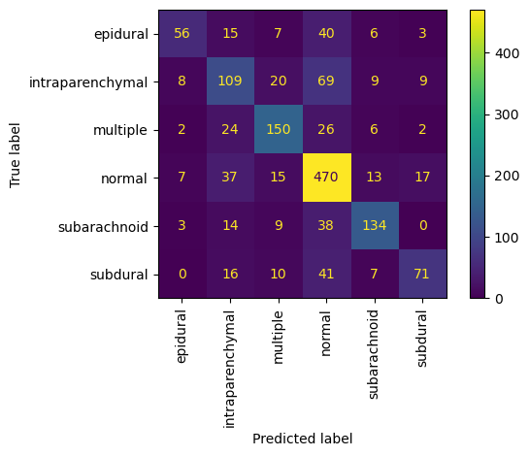
Model 2: Convolution Neural Network
Larger sample size, around 8000
Down sampling in one axis
67% testing accuracy
84% accuracy on "normal" category
Other categories range in accuracy from 47% to 71%
Notes:
David

Slide 7
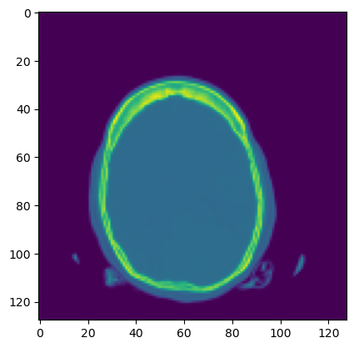
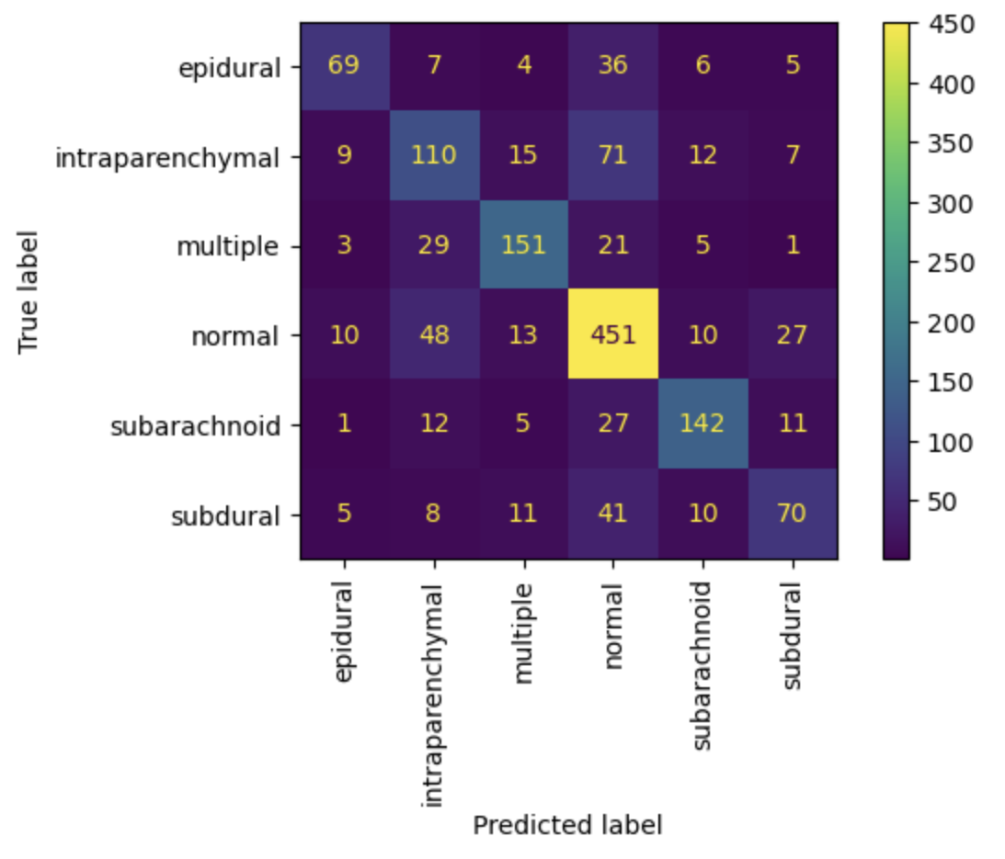
Model 3: Convolution neural Network 2
Cleaner down sampling (on both axes)
Sample size around 8000
69% testing accuracy
Only a slight improvement
Notes:
David

Slide 8
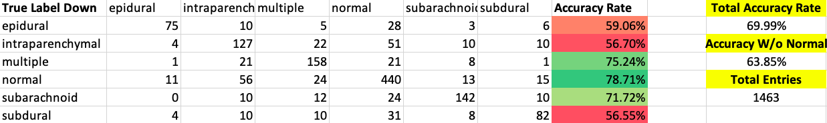
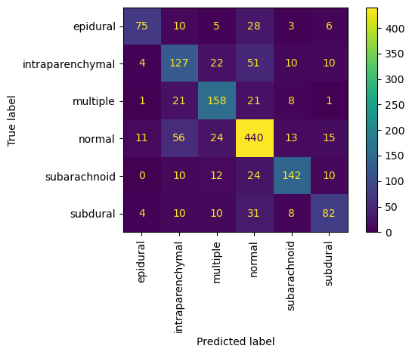
Model 4: Final CNN With Accurate DS
Better Down Sampling
Lowered Accuracy with "normal" categorization
Increased accuracy with other categories
Small increase in total model accuracy offset by performance shifts
Better model due to interest case in non-"normal" hemorrhages
Notes:
Jared

Slide 9
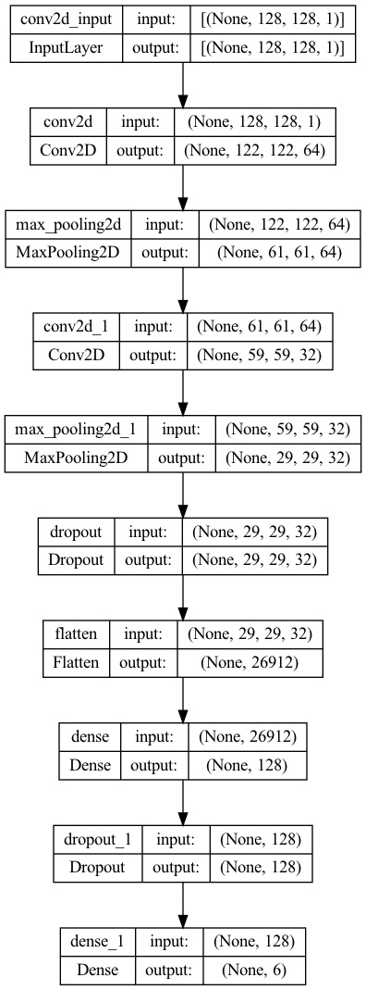
Final Model Implementation
Notes:
Karenna

Slide 10
Future improvements
We could not process multiple CT images at a time as an input. In a real situation, there would be several scans from multiple levels on the same patient. We were unable to implement it here, but we believe this would significantly improve results.
We would use even more data, especially data for the labels that have fewer entries in the data we used. This would help more evenly train the model and improve its accuracy.
We would increase our GPU, as long training times prevented us from using full resolution data or adding many more convolutional layers, which likely would have improved performance.
Notes:
Scott

Slide 11
Thanks & Resources
Thanks to:
Prof. Wang for lectures and resources, TAs, and the friends we made along the way.
Zeta Surgical, for the CT scans and labels.
Papers Referenced:
M. Arbabshirani, B. Dornwalt, G. Mongelluzzo, J. Suever, B. Geise, A. Patel, and G. Moore. Advanced machine learning in action: identification of intracranial hemorrhage on computed tomography scans of the head with clinical workflow integration. Nature, 2018.
O. Faruk Ertugrul and M. Fatih Akil. Detecting hemorrhage types and bounding box of hemorrhage by deep learning. BSPC, 2022.
A. Kundisch, A. Honning, S. Mutze, L. Kreissl, F. Spohn, J. Lemcke, M. Sitz, P. Sparenberg, and L. Goelz. Deep learning algorithm in detecting intracranial hemorrhages on emergency computed tomographies. PLoS ONE, 2021.

